Slide 1
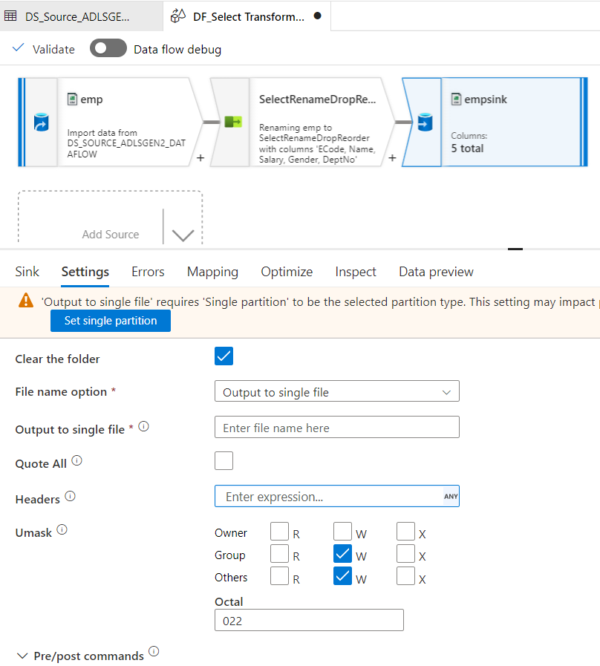


Slide 2
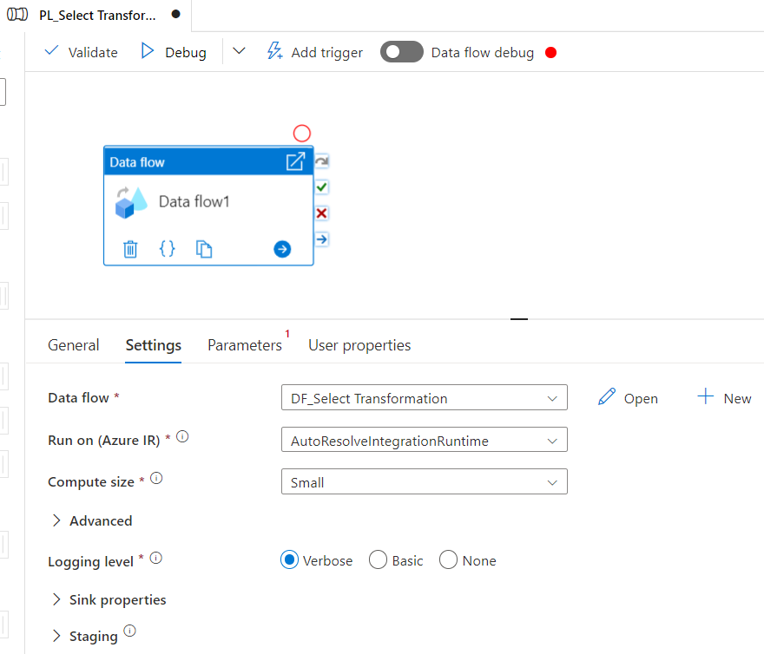
Create Pipeline
Drag & drop Data Flow

Slide 4
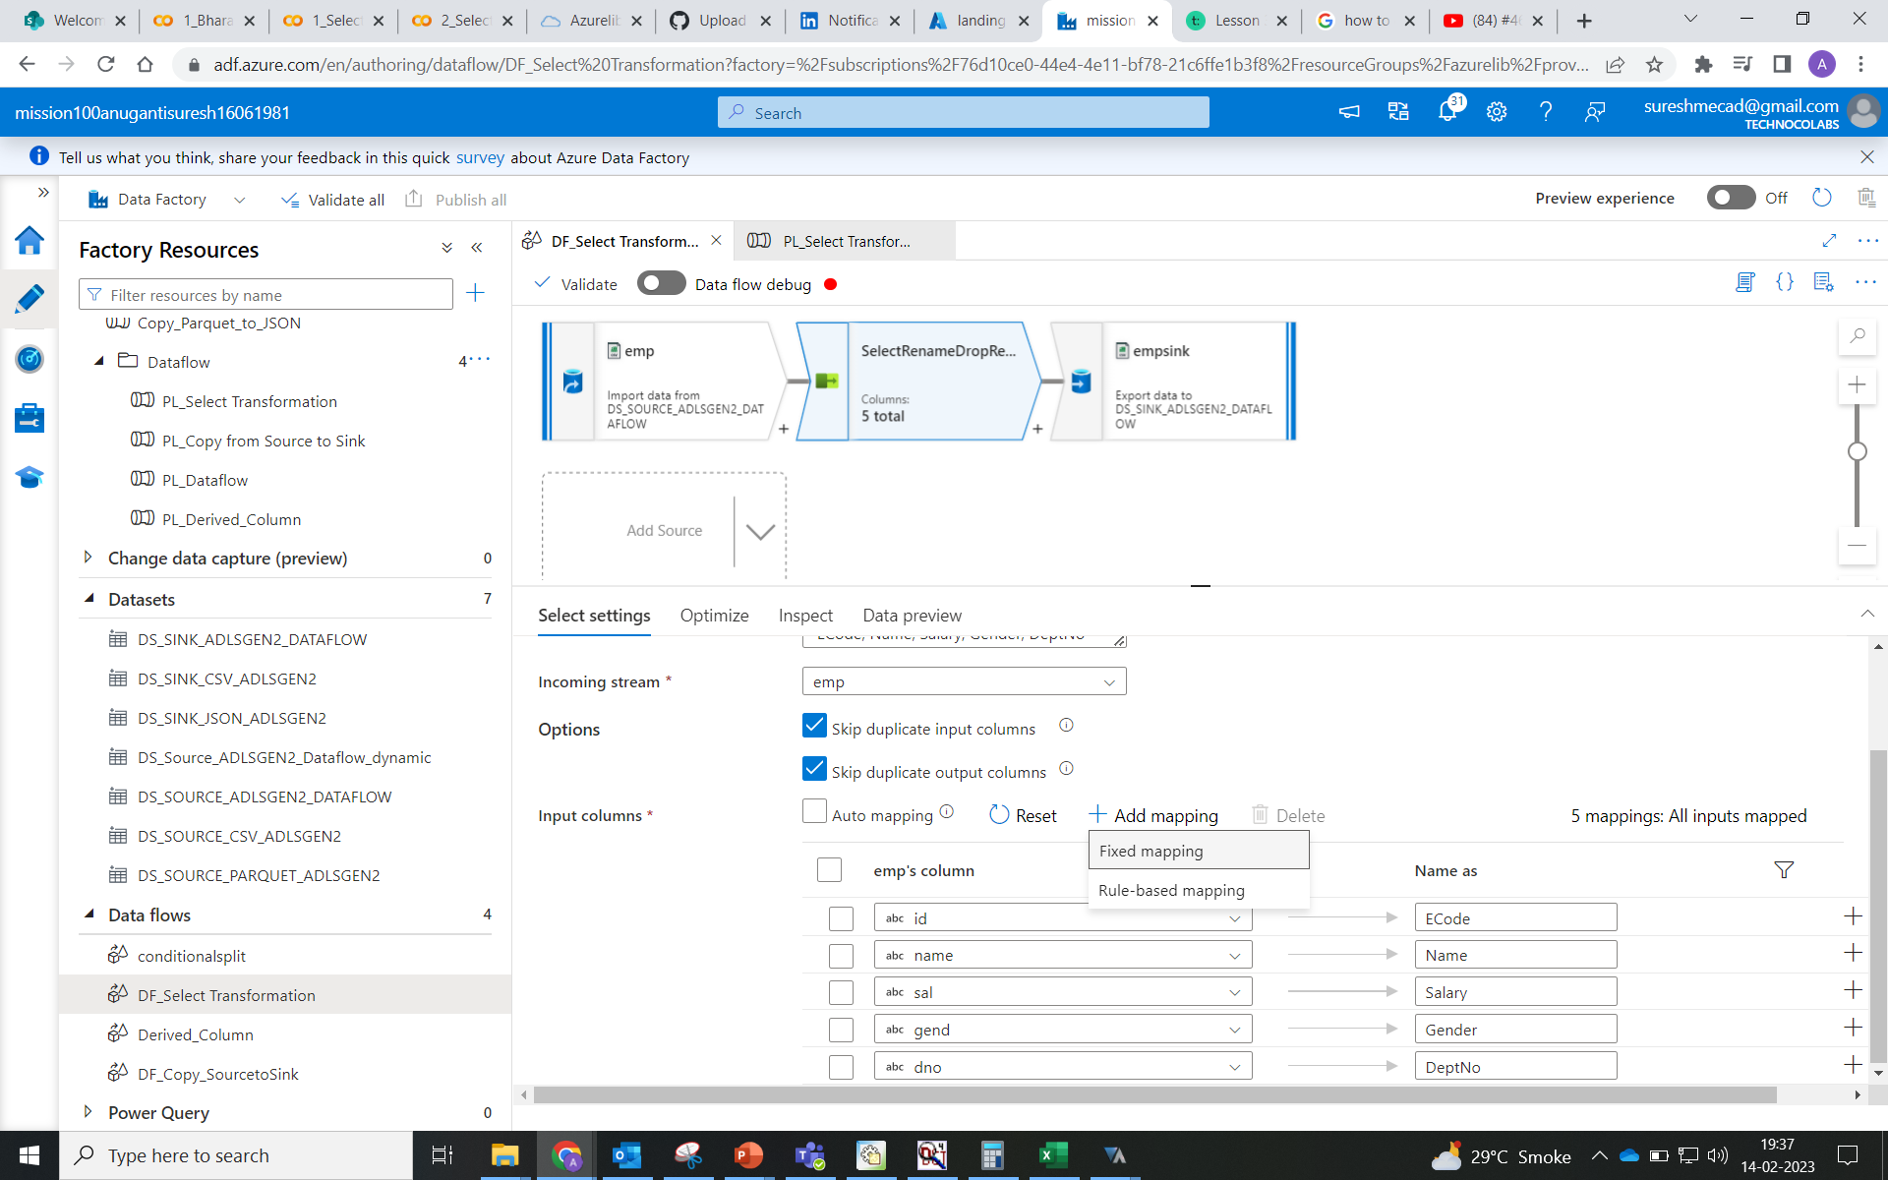
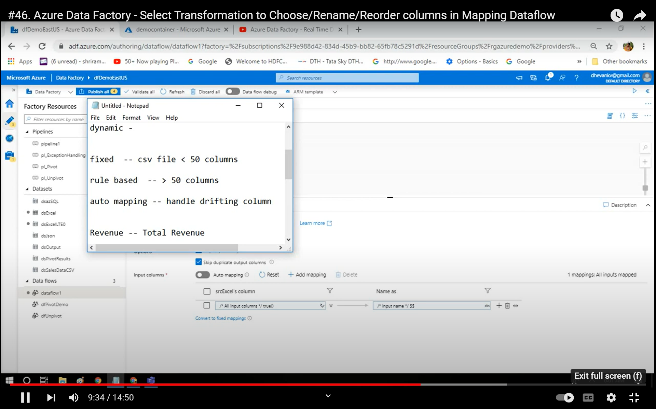
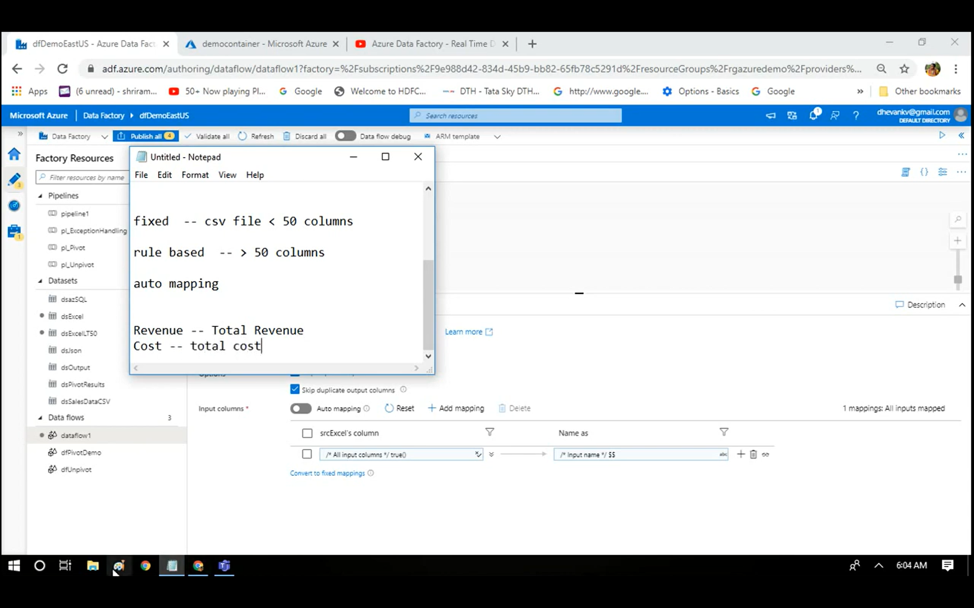
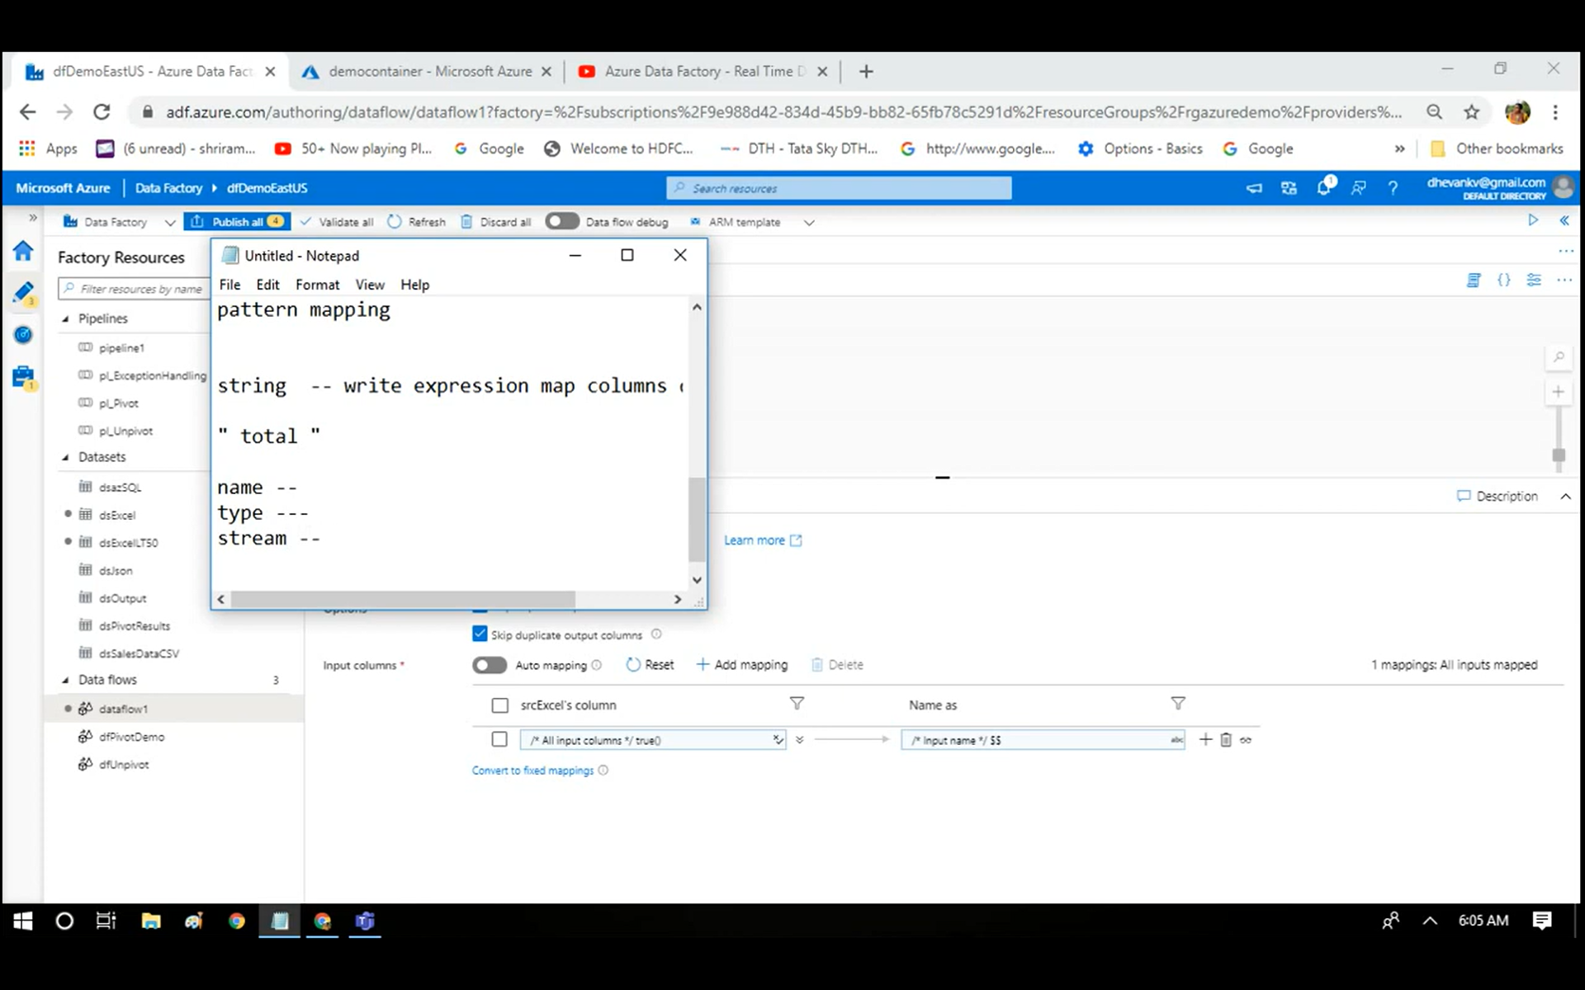

Slide 5
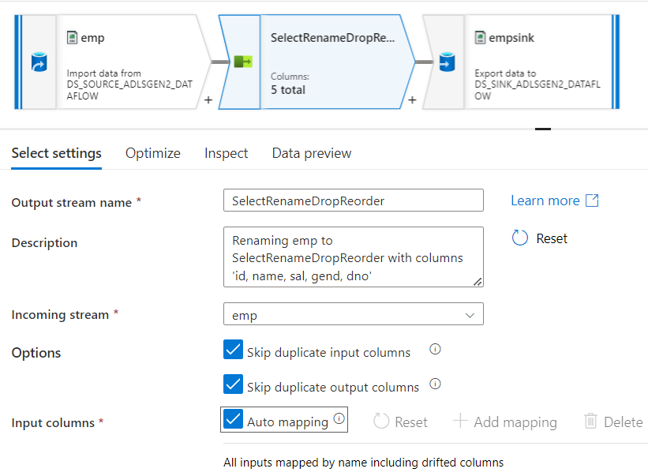
Auto mapping:
Since source file has fewer columns, this mapping done automatically.
Handle drifting column (if you want ADF to handle any new columns in future
Auto map columns to sink dataset

Slide 6
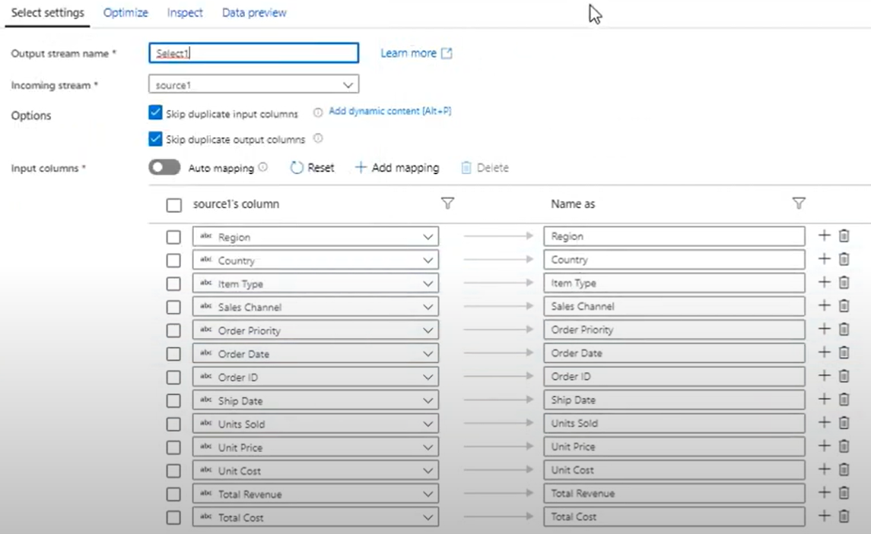
Fixed mapping:
CSV file < 50 columns
Whatever the name of the column will be the same name in the alias column. Sink uses same column names.

Slide 7
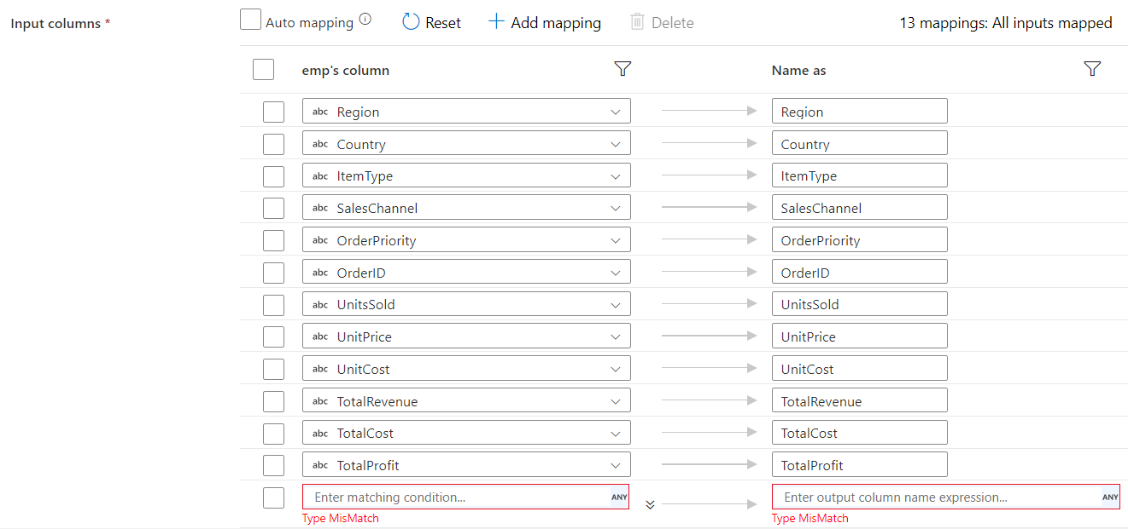
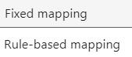
Rule-based mapping:

Slide 8
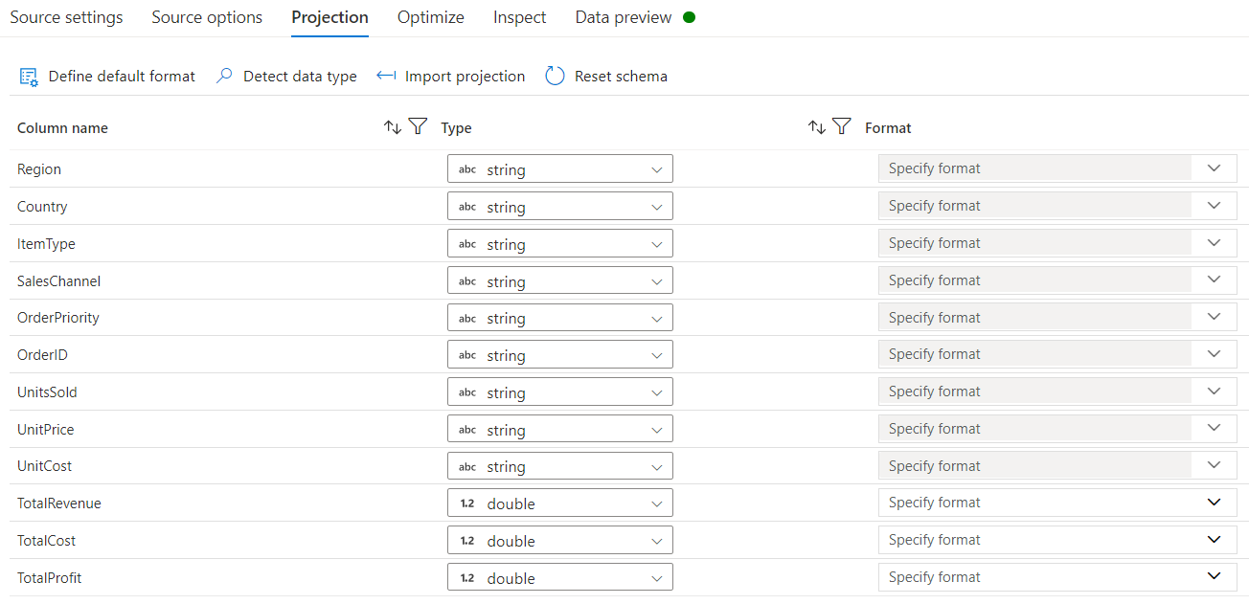

Slide 9
